Slide 1
Class of 2020 Senior Parent Night
October 30, 2019

Slide 2
Welcome!
Introductions:
Ned Floeter, Principal
Julie Avery, Registrar
Brandyn Bates, College Prep English
Brad Donovan, Senior English
Megan McNelly, GEAR UP Specialist
Kate Languell, School Counselor
Nancy Morris, Superintendent

Slide 3
Why Are We Here?
Exciting, scary, busy time!
School, parents, and students work together to help students take advantage of opportunities
Graduation Requirements
Plans for beyond HS
Ned Floeter
Principal

Slide 4
Visit our Website
www.willapavalley.org
High School Page
Senior resources
College links, Tech school links, FAFSA link, Family Access and more!
E-Alerts
Calendar of events
Staff contact information

Slide 5
Graduation Requirements: Class of 2020
24 Credits
Culminating Senior Project
HS and Beyond Plan
Complete Portfolio
SB ELA & Math
English Language Arts (meet proficiency)
Math
NEW! Alternate Pathways (handout)

Slide 6
Senior Class Requirements
Job Shadow—Happening NOW
Students should find someone in career area of interest
One day shadow; paperwork
Community Service
40 hours (graduation)
50 hours if World Class Scholar

Slide 7
Culminating Projects
College Prep English: Mr. Bates
10-12 page academic paper (current events)
Senior English: Mr. Donovan
24-hour project plus short paper on related topic
All students have culminating interview

Slide 8
Graduation Requirement: Portfolio
Academic Portfolio
Completion date: May 1, 2020
Staff Review
Final Due date: May 15, 2020
Teri Larew
Portfolio Coordinator

Slide 9
Selective Service, Diplomas, and More, OH MY!
Diploma Information
Fill out for official diploma
Transcripts requests
Voter Registration
Draft registration
Julie Avery
Registrar

Slide 10
Let’s Make Plans for 13th Year….
Testing
SAT and ACT (Should happen NOW)
College & Program Applications
2 Days Absences for Program Visitations are School Related / Excused Absences

Slide 11
GEAR UP is here to help!
Field trips to colleges and universities
Cultural events and experience-enhancers
Funding for PSAT, SAT, ACT
Help with filling our financial aid forms
College, career guidance
Megan McNelly

Slide 12
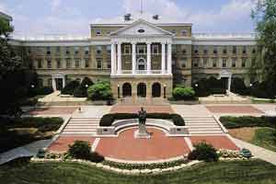
4-Year University
SAT, ACT
Get the score you want, or re-take
Schools will take the best of your tests
Visit schools
See Admissions Office, campus tour
Visit while school is in session
APPLY EARLY, APPLY NOW!
WUE: Western Undergraduate Exchange

Slide 13
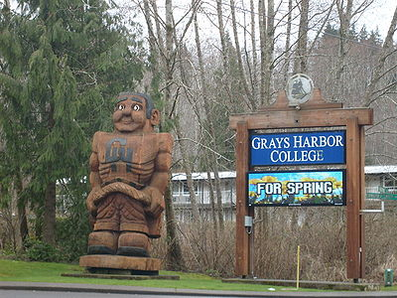
Community College
Check out programs
Check out credit transfer
Centralia CC
South Puget Sound CC
Lower Columbia CC
Grays Harbor CC

Slide 14
World Class Scholars--GHC
World Class Scholars Web Page
Check your requirements to make sure you are eligible
GPA
Portfolio
Community Service

Slide 15
Vocational Schools
Bates Technical College
Grays Harbor College Technical
Clover Park Technical College
Perry Technical Institute

Slide 16
Military Service
Army
Navy
Air Force
Marines
Coast Guard
ROTC: (Reserve Officer Training Corps)
See college ROTC office
Programs for different military branches in different colleges

Slide 17
Scholarships and Financial Aid
Financial Aid information
Watch for scams
www.fafsa.ed.gov
Financial Aid Workshop
GHC Riverview Center (November)
www.fastweb.com
www.thewashboard.org
www.collegenet.com
College Bound Scholarship Website
Scholarships
Grants
Loans

Slide 18
Questions?
Let us know how we can help.
We are here to help, to answer questions, and to find an answer when we don’t know it!

